Slide 1
What makes an Android App popular?
Presented by Xu Han, Data Science ScM
Oct 20, 2019
Github repo
Notes:
https://github.com/bao1981105/Google-Apps-Download-Prediction

Slide 2
Introduction
People nowadays spend more time with their phones. While this is a great opportunity for the market, it also becomes a challenge for developers to develop a popular app. The data was downloaded from Kaggle.
In this project, the goal is to predict the number of installs from features of the app itself such as category, size, current version, rating, paid or free etc.
Target variable: number of installs. ‘<10k’, ‘<500k’, ‘<5 million’, ‘> 5 million’.
Classification problem.
Notes:
https://www.kaggle.com/lava18/google-play-store-apps

Slide 3
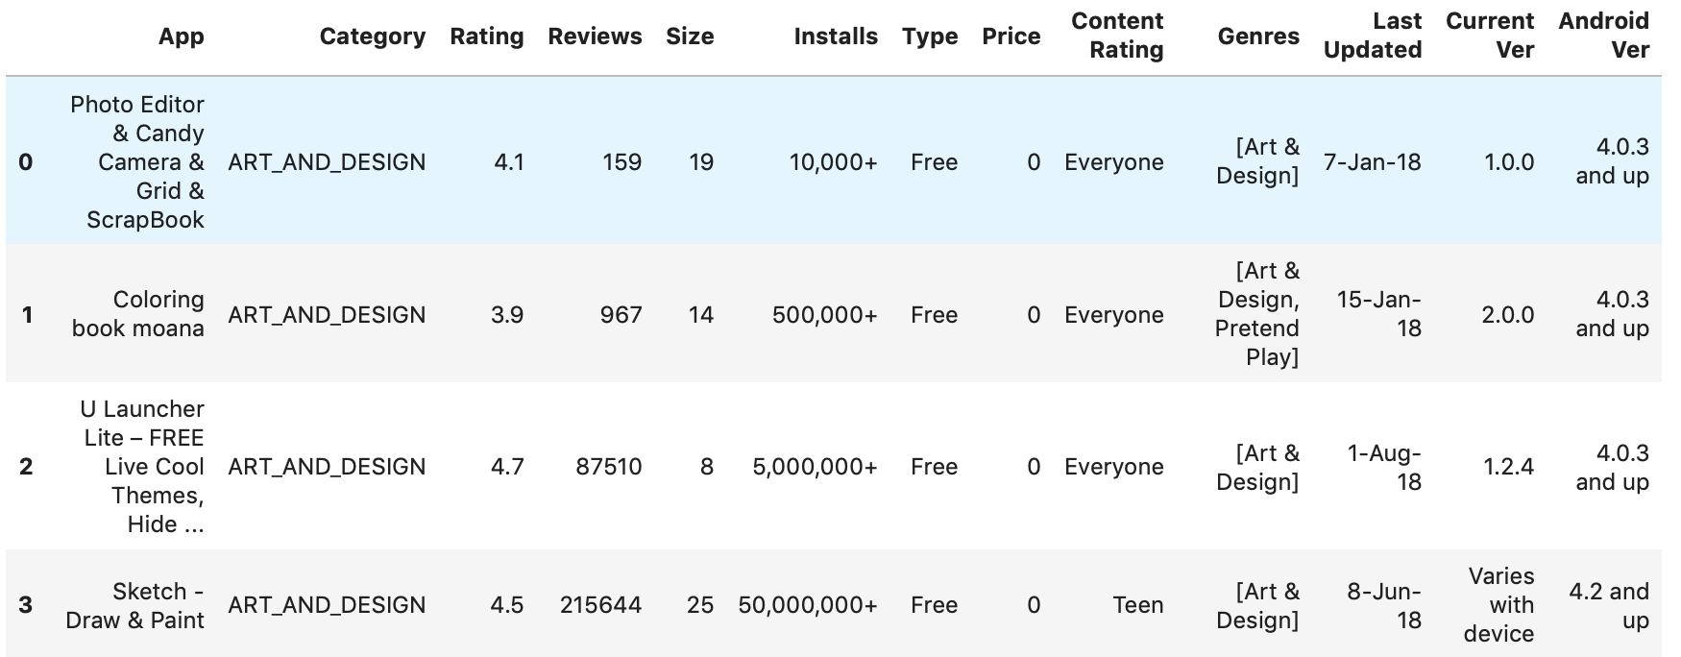
Preprocessing: Original df

Slide 4
Preprocessing: Data Cleaning
Original df shape: (10841, 13); df_preprocessed shape: (9676, 68)
Drop duplicates, use RegEx to adjust columns that has datatype ‘Object’
Ordinal: Installs (df.replace and reduce to four groups), Content Rating
Onehot: Category, Genres, Type
Minmax scaler: Last Upated, Rating, Size, Price
Standard scaler: Reviews

Slide 5
Preprocessing: Missing values
Run MCAR test on df_preprocessed (test result p = 0)
Train test split
Iterative impute missing values for continuous features in test dataset
For missing values in categorical features, make a new column addressing missingness. Exp: ‘Size’, ‘Current Version’, ‘Android Version’
Check percentage of missing data and drop columns that has 91% missing

Slide 6
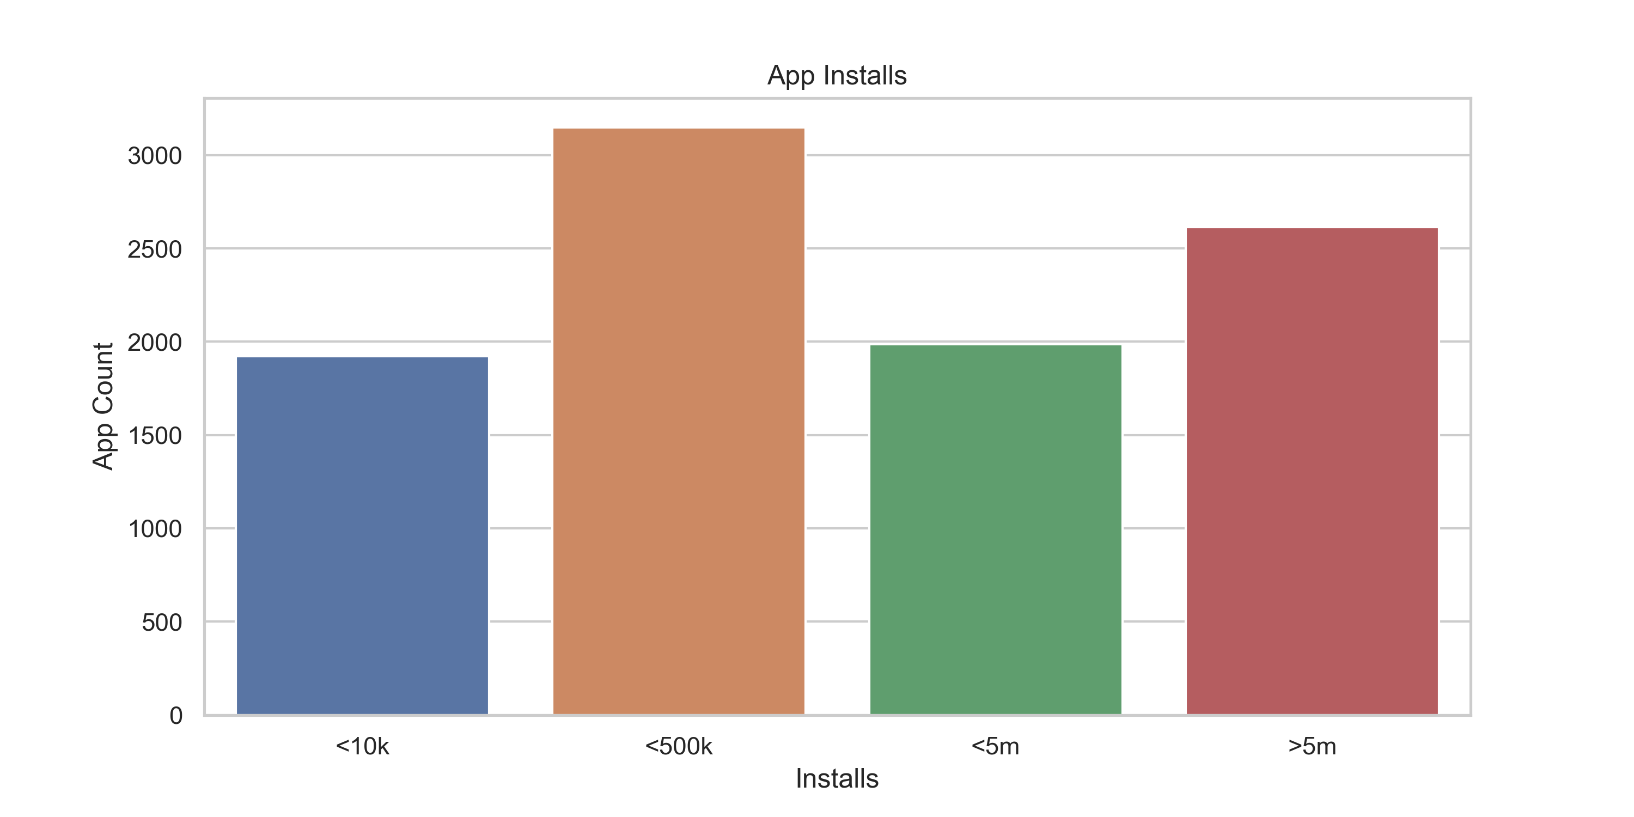
EDA: Data Balance

Slide 7
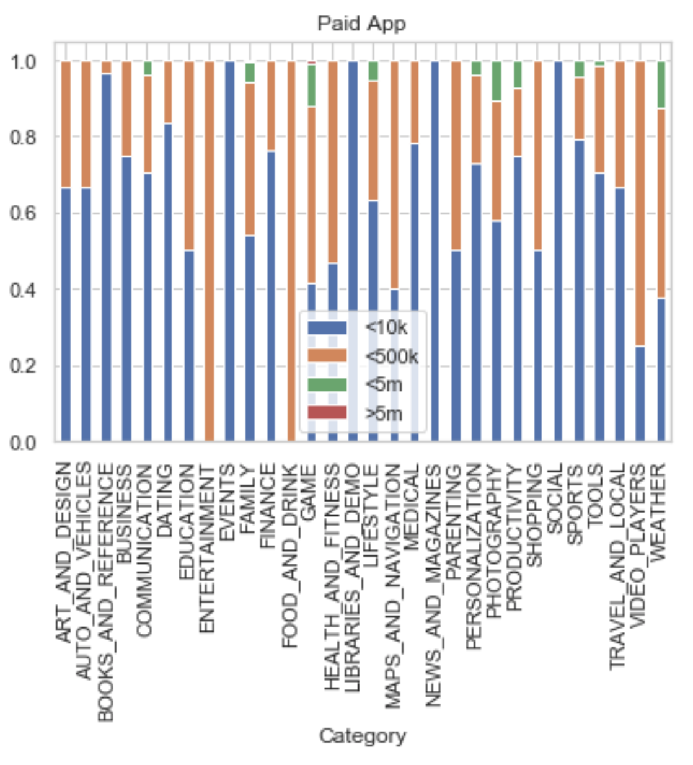
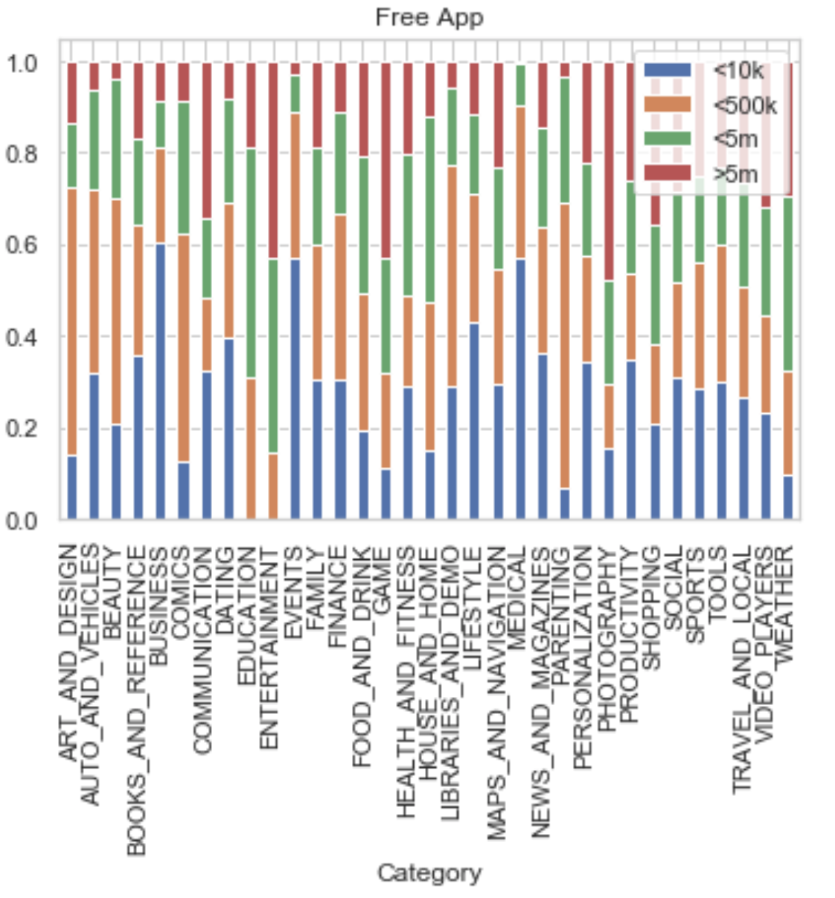
EDA: Free & entertainment apps more popular

Slide 8
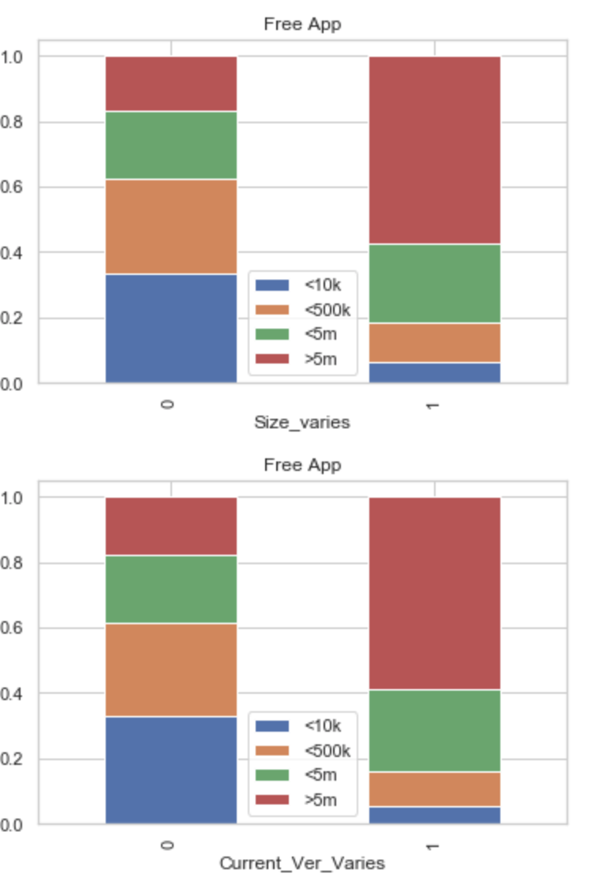
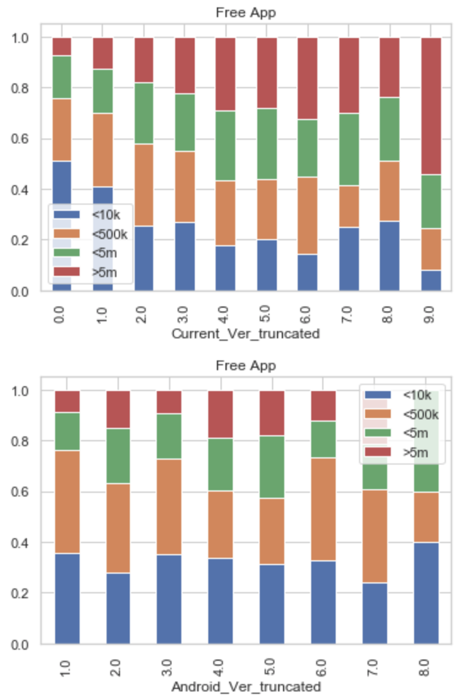
EDA: Android device

Slide 9
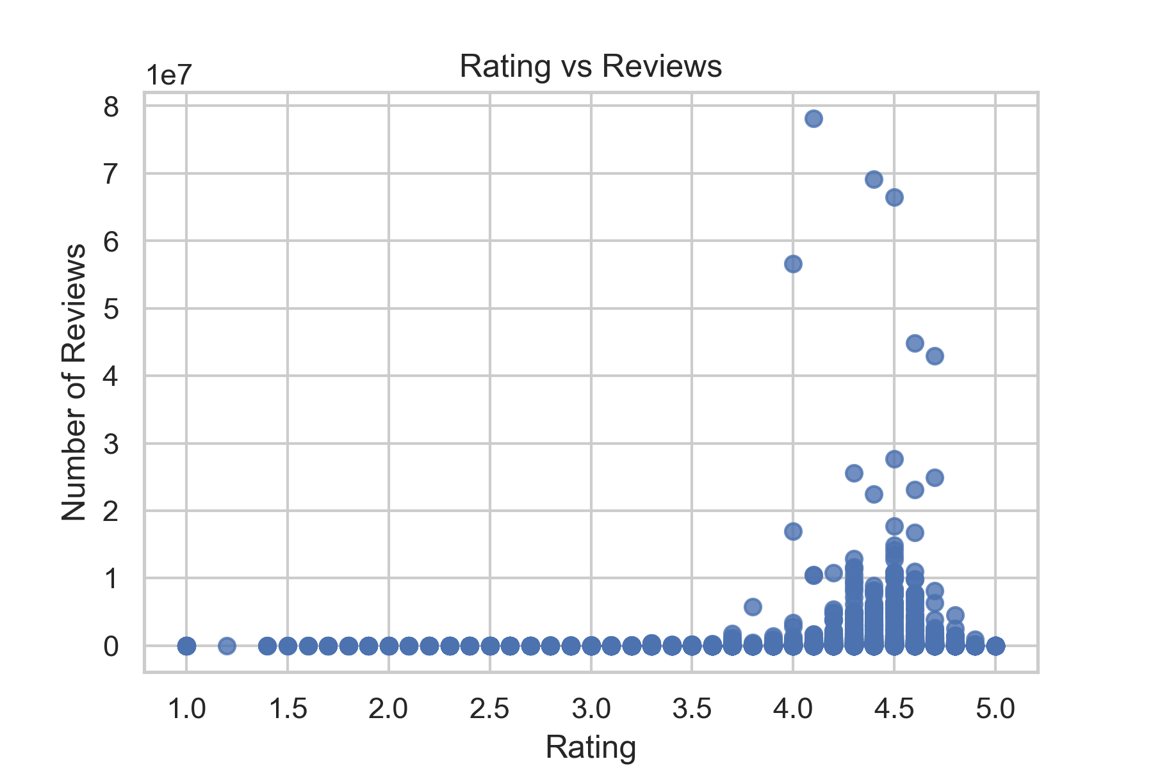
EDA Continuous Features

Slide 10
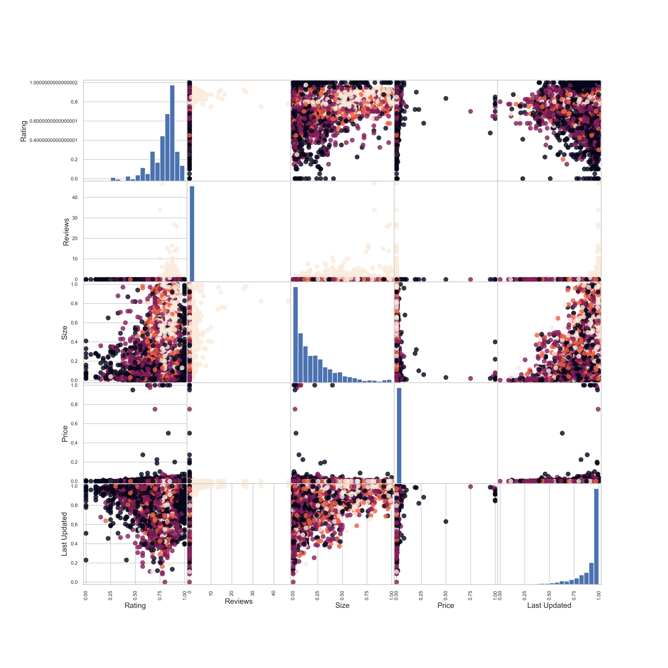
EDA Continuous Features
Rating: Left skewed
Size: Right skewed, most apps have small sizes
Price: Most apps are free
Reviews: Most apps have very few reviews
Last updated: Most apps are updated recently

Slide 11
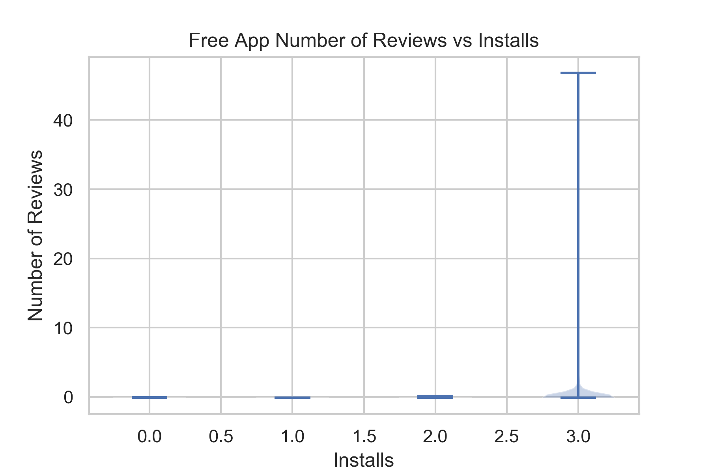
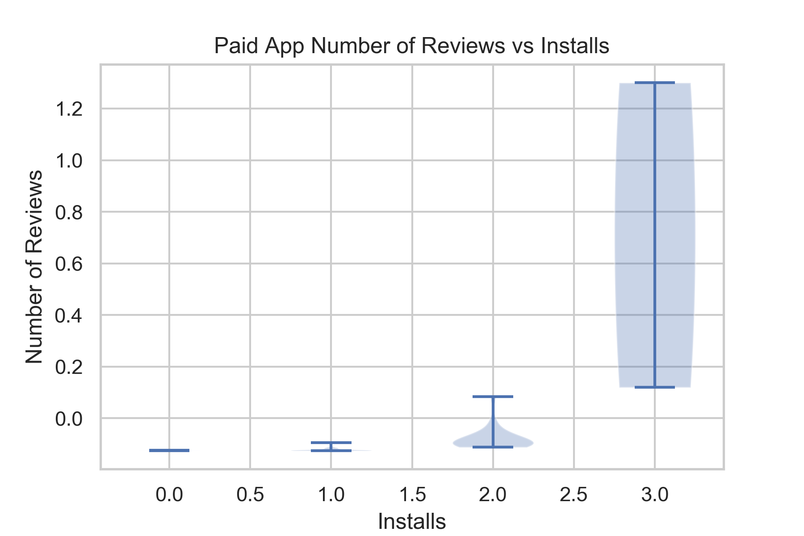
EDA: People care about popular paid app?

